Slide 1

Defining Networks with the OSI Model
Module 2

Slide 2
Objectives
Skills Concepts | Objective Domain Description | Objective Domain Number
Understanding OSI Basics Defining the Communications Subnetwork Defining the Upper OSI Layers | Understand the OSI Model | 3.1
Defining the Communications Subnetwork | Understand Switches | 3.1
Notes:
This should also be a review for the 70-642.

Slide 3
Standards
Standards are sets of rules that ensure hardware and software released from different companies work together
Examples of Organizations that Coordinate Standards:
International Organization for Standardization (ISO) – Federation of standards organizations from multiple nations
American National Standards Institute (ANSI) – Responsible for coordinating and publishing computer and information technology standards in the United States
International Electrical and Electronics Engineers (IEEE) – Professional organization for the electrical and electronics field

Slide 4
Open Systems Interconnection (OSI)
The Open Systems Interconnection (OSI) reference model is used to define how data communication occurs between devices
The model is divided into 7 layers, each layer providing services to the layers above and below
Layer | Defines
Layer 7 – Application Layer | Enables users and applications to access network services
Layer 6 – Presentation Layer | Translates data into a common format
Layer 5 – Session Layer | Establishes a communication session between devices
Layer 4 – Transport Layer | Manages message fragmentation and reassembly
Layer 3 – Network Layer | Manages data routing and creating sub networks
Layer 2 – Data Link Layer | Provides error-free transfer of data frames
Layer 1 – Physical Layer | Physical network media and signal methods
Notes:
All People Seem To Need Data Processing. That mnemonic progresses from layer 7 to layer 1. For a mnemonic that goes in the opposite direction, try Please Do Not Throw Sausage Pizza Away. Or, just memorize the real layer names! It’s up to you.

Slide 5
OSI Model Layers
Layer | Protocol Data Unit (PDU)
Application | Data
Presentation | Data
Session | Data
Transport | Segment
Network | Packet
Data Link | Frame
Physical | Bits
Layer | Protocol Data Unit (PDU)
Application | Data
Presentation | Data
Session | Data
Transport | Segment
Network | Packet
Data Link | Frame
Physical | Bits
The Wire

Slide 6
Layer 1 – Physical Layer
Defines the physical and electrical medium for data transfer
Physical layer components: cables, jacks, patch panels, punch blocks, hubs, and MAUs
Physical layer concepts: topologies, analog versus digital/encoding, bit synchronization, baseband versus broadband, multiplexing, and serial data transfer
Unit of measurement: Bits

Slide 7
Communications Subnetwork
The communications subnetwork consists of layers 1 through 3
  Physical
  Data Link
  Network
Regardless of what type of data transmission occurs in a computer network, the communication subnetwork is used

Slide 8
Ethernet Standards
LAN standard providing a communication method for high speed data exchange among devices
Defined Physical and Data Link Layer
100BASE-T
  100 for 100 Mbps
  BASE for baseband
  T for twisted-pair cabling
Baseband refers to the fact that devices on the network use digital signaling over a single frequency
Broadband systems use analog signaling over a range of frequencies enabling multiple channels over the same physical medium

Slide 9
Layer 2 – Data Link Layer
Establishes, maintains, and decides how transfer is accomplished over the physical layer and ensures error-free transmission over the physical layer
Physical addresses (the hexadecimal address that is burned into the ROM of the NIC), known as the MAC address uniquely identify each hardware device work at the Data Link Layer
Data Link Layer components: network interface cards and bridges
Unit of measurement: frames

Slide 10
Media Access Control Address
Network adapters on an Ethernet network have unique Media Access Control (MAC) addresses
MAC addresses are unique identifiers assigned to network adapters by the manufacturer
MAC address is six octets in length written in hexadecimal
Notes:
Demo “ipconfig /all” to display MAC address

Slide 11
Layer 2 Switches
Layer 2 switches are hardware-based and use the MAC address of each host computer’s network adapter when deciding where to direct data frames
Ports on the switch are mapped to the specific MAC address of the device attached
00:2a:db:38:9c:f1
23:5c:f7:da:9c:32

Slide 12
Virtual LAN (VLAN)
Layer 2 switching can also allow for a virtual LAN (VLAN) to be implemented.
A VLAN is implemented to segment and organize the network, to reduce collisions, boost performance
IEEE 802.1Q is the standard that supports VLANs
A tag is added to the data frame to identify the VLAN
VLAN2
VLAN1

Slide 13
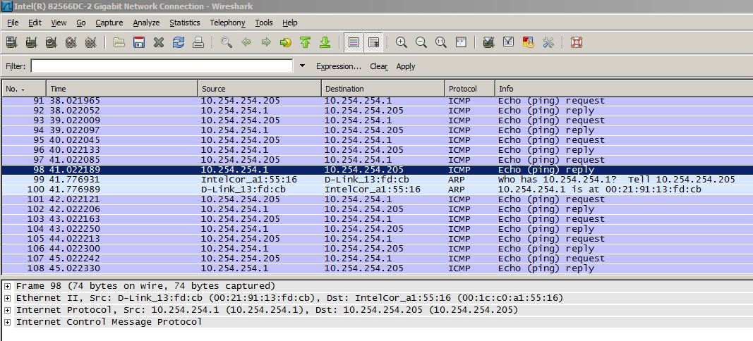
Packets

Slide 14
Layer 3 – Network Layer
Controls the operations of routing and switching information to different networks
Translates logical addresses or names to physical addresses
Internet Protocol (IP) is a Network Layer protocol
Devices that work at the network layer are routers and IP switches
Network Layer components: IP addresses, subnets
Unit of measurement: packets

Slide 15
Layer 3 Switches
Switches can also reside on the network layer
A layer 3 switch determines paths for data using logical addressing (IP addresses) instead of physical addressing (MAC addresses for a layer 2 switch)
Layer 3 switches forward packets, whereas layer 2 switches forward frames
192.168.1.1
192.168.2.1

Slide 16
Layer 4 – Transport Layer
This layer ensures messages are delivered error-free, in sequence and with no losses or duplications
Protocols that work at this layer segment messages, ensure correct reassembly at the receiving end, perform message acknowledgement and message traffic control
The Transport Layer contains both connection-oriented and connectionless protocols
Unit of measurement used: segments or messages

Slide 17
Connection Oriented Communications
Require both devices involved in the communication establish an end-to-end logical connection before data can be sent
These communications are considered reliable network services
Packets not received by the destination device can be resent by the sender

Slide 18
Connectionless Communications
End-to-end connection is not necessary before data is sent
Every packet that is sent has the destination address in the header
Sufficient to move independent packets, such as in streaming media
Datagram delivery is not guaranteed and lost packets cannot be resent

Slide 19
Connection-based Protocols
The Transport Layer contains both connection-oriented and connectionless protocols
Transmission Control Protocol (TCP) provides a connection-based, reliable, byte-stream service to programs
User Datagram Protocol (UDP) provides a connectionless, unreliable transport service

Slide 20
TCP and UDP
TCP transport is used for logging on, file and print sharing, replication of information between domain controllers, transfer of browse lists, and other common functions. TCP can only be used for one-to-one communications.
UDP is often used for one-to-many communications, using broadcast or multicast IP datagrams
Protocol | Type | Example
Transmission Control Protocol (TCP) | Connection-oriented | Web browser
User Datagram Protocol (UDP) | Connectionless | Streaming media

Slide 21
Ports
Ports are a Layer 4 protocol that a computer uses for data transmission
Ports act as logical communications endpoint for specific program on computers for delivery of data sent
There are a total of 65,536 ports, numbering between 0 and 65,535
Ports are defined by the Internet Assigned Numbers Authority or IANA and divided into categories
Notes:
For information about specific TCP/IP port assignments, see RFC 1700 on the Information Sciences Institute Web site at the following location: ftp://ftp.isi.edu/in-notes/rfc1700.txt

Slide 22
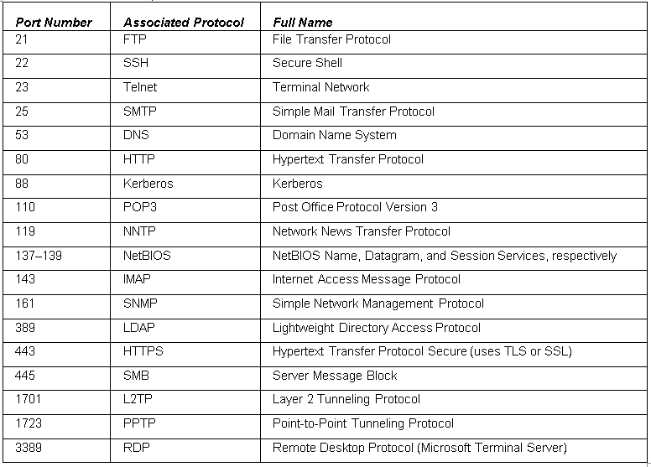
Ports

Slide 23
Layer 5 – Session Layer
The Session Layer manages session establishment, maintenance and termination between network devices
Example: when you log on and log off
This layer controls the name and address database for the OS
NetBIOS (Network Basic Input Output System) is a protocol that works at this layer
Notes:
Demonstrate using NetStat command

Slide 24
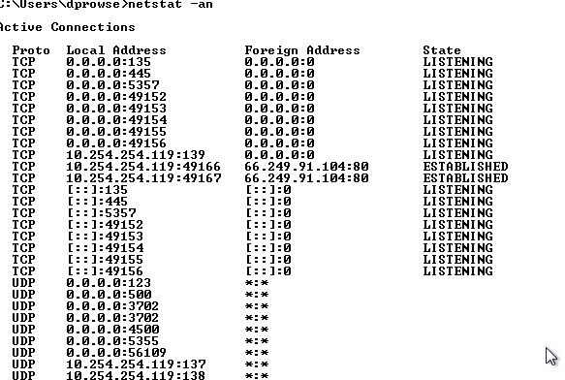
NetStat Command
Notes:
This will display a list of all the connections to and from your computer in numeric format

Slide 25
Layer 6 – Presentation Layer
This layer translates the data format from sender to receiver in the various OSes that may be used
Presentation Layer concepts include: character code conversion, data compression, and data encryption
Redirectors work on this layer, such as mapped network drives that enable a computer to access file shares on a remote computer

Slide 26
Layer 7 – Application Layer
Serves as a the window for users and application processes to access network services
This layer is where message creation begins
End-user protocols such as FTP, SMTP, Telnet, and RAS work at this layer
This layer is not the application itself, but the protocols that are initiated by this layer

Slide 27
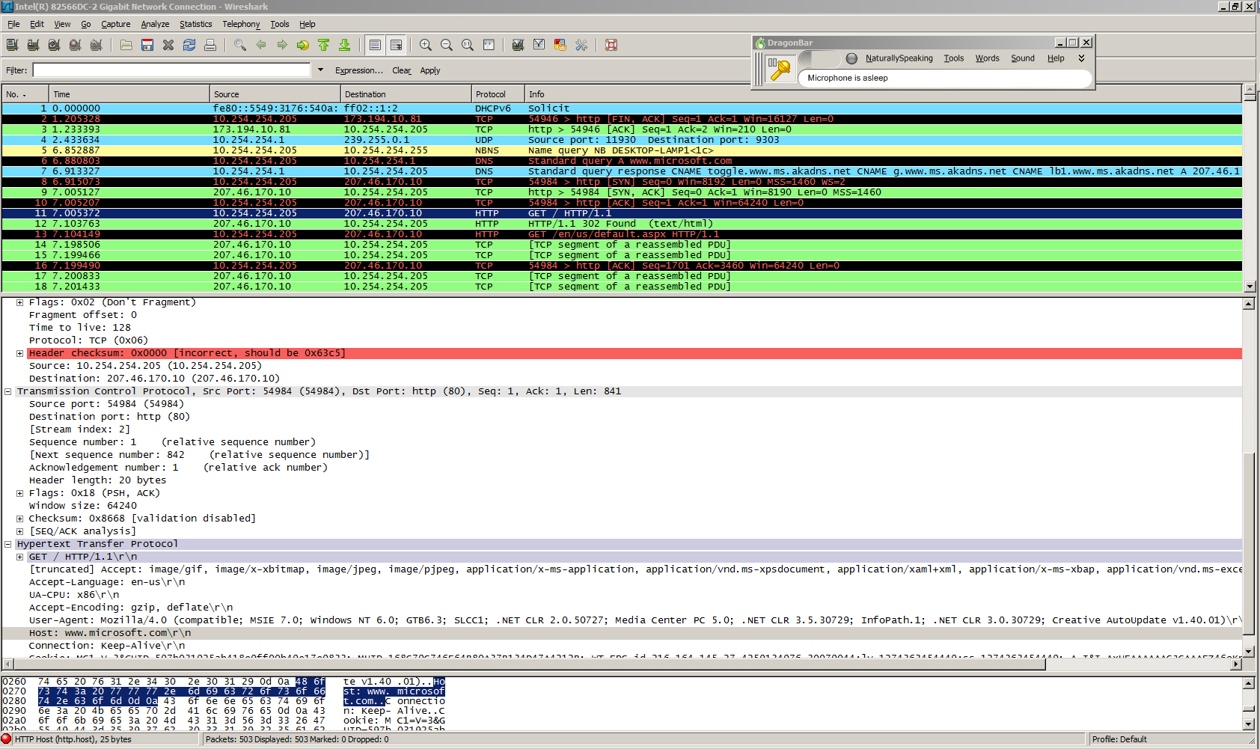
HTTP Packet

Slide 28
OSI Model Revisited
Layer | Protocol | Device
7 – Application | FTP, HTTP, POP3, SMTP | Gateway
6 – Presentation | Compression, Encryption | N/A
5 – Session | Logon/Logoff | N/A
4 – Transport | TCP, UDP | N/A
3 – Network | IP, ICMP, ARP, RIP | Routers
2 – Data Link | 802.3, 803.5 | NICs, Switches, Bridges, WAPs
1 – Physical | 100BASE-T, 1000BASE-X | Hubs, Patch Panels, RJ45 Jacks

Slide 29
TCP Model
The TCP/IP model is similar to the OSI model
This model is composed of only four layers
Layer | Description | Protocols
Application Layer | Defines TCP/IP application protocols | HTTP, Telnet, FTP, SMNP, DNS
Transport Layer | Provides communication session management | TCP, UDP, RTP
Internet Layer | Packages and routes data | IP, ICMP, ARP, RARP
Network Interface | Details how data is physically sent through the network | Ethernet, Token Ring, Frame Relay

Slide 30
OSI Model compared to TCP Model
OSI Model | TCP Model
Application Layer | Application Layer
Presentation Layer
Session Layer
Transport Layer | Transport Layer
Network Layer | Internet Layer
Data Link Layer | Network Access Layer
Physical Layer
The OSI Physical layer is skipped altogether on the TCP model

Slide 31
Summary
Understand the OSI model by defining each of the layers from a theory perspective
Be able to separate the functions of the lower levels of the OSI model, from the upper levels where message creation begins.
Understand the differences between layer 2 and layer 3 switches, and gain a basic understanding of how they operate.
Differentiate between the OSI model and the TCP model.

Slide 32
Additional Resources & Next Steps
Instructor-Led Courses
  40033A: Windows Operating System and Windows Server Fundamentals: Training 2-Pack for MTA Exams 98-349 and 98-365 (5 Days)
  40349A: Windows Operating System Fundamentals: MTA Exam 98-349 (3 Days)
  40032A: Networking and Security Fundamentals: Training 2-Pack for MTA Exams 98-366 and 98-367 (5 Days)
  40366A: Networking Fundamentals: MTA Exam 98-366
Books
Exam 98-366: MTA Networking Fundamentals (Microsoft Official Academic Course)
Exams & Certifications
  Exam 98-366: Networking Fundamentals

Slide 33

© 2012 Microsoft Corporation. All rights reserved. Microsoft, Windows, Windows Vista and other product names are or may be registered trademarks and/or trademarks in the U.S. and/or other countries.
The information herein is for informational purposes only and represents the current view of Microsoft Corporation as of the date of this presentation. Because Microsoft must respond to changing market conditions, it should not be interpreted to be a commitment on the part of Microsoft, and Microsoft cannot guarantee the accuracy of any information provided after the date of this presentation.
MICROSOFT MAKES NO WARRANTIES, EXPRESS, IMPLIED OR STATUTORY, AS TO THE INFORMATION IN THIS PRESENTATION.

