Slide 1
Defining Networks with the OSI Model
Networking Fundamentals Module 2

Slide 2
Open Systems Interconnection (OSI)
The OSI model is used to define how data communication occurs on computer networks.
The model is divided into 7 layers, each layer providing services to the layers above and below it.
Layer | Defines
Layer 7 – Application Layer | Enables users and applications to access network services
Layer 6 – Presentation Layer | Translates data into a common format
Layer 5 – Session Layer | Establishes a communication session between devices
Layer 4 – Transport Layer | Manages message fragmentation and reassembly
Layer 3 – Network Layer | Manages data routing and creating sub networks
Layer 2 – Data Link Layer | Provides error-free transfer of data frames
Layer 1 – Physical Layer | Physical network media and signal methods

Slide 3
OSI Model Layers
Layer | Protocol Data Unit (PDU)
Application | Data
Presentation | Data
Session | Data
Transport | Segment
Network | Packet
Data Link | Frame
Physical | Bits
Layer | Protocol Data Unit (PDU)
Application | Data
Presentation | Data
Session | Data
Transport | Segment
Network | Packet
Data Link | Frame
Physical | Bits
The Wire

Slide 4
Protocol Stack
Sometimes a protocol suite such as TCP/IP is referred to as a protocol stack.
The OSI Model shows how a protocol stack works on different levels of transmission (how it stacks up against the model).

Slide 5
Layer 1 – Physical Layer
Defines the physical and electrical medium for data transfer
Physical layer components: cables, jacks, patch panels, punch blocks, hubs, and MAUs
Physical layer concepts: topologies, analog versus digital/encoding, bit synchronization, baseband versus broadband, multiplexing, and serial data transfer
If you can touch a network element, it is part of the physical layer
Unit of measurement: Bits

Slide 6
Layer 2 – Data Link Layer
Establishes, maintains, and decides how transfer is accomplished over the physical layer and ensures error-free transmission over the physical layer
Physical addresses (the hexadecimal address that is burned into the ROM of the NIC), known as the MAC address uniquely identify each hardware device work at the Data Link Layer
Data Link Layer components: network interface cards and bridges
Unit of measurement: frames

Slide 7
Layer 3 – Network Layer
Controls the operations of routing and switching information to different networks
Translates logical addresses or names to physical addresses
Internet Protocol (IP) is a Network Layer protocol
Devices that work at the network layer are routers and IP switches
Network Layer components: IP addresses, subnets
Unit of measurement: packets

Slide 8
Layer 4 – Transport Layer
This layer ensures messages are delivered error-free, in sequence and with no losses or duplications
Protocols that work at this layer segment messages, ensure correct reassembly at the receiving end, perform message acknowledgement and message traffic control
The Transport Layer contains both connection-oriented and connectionless protocols
Unit of measurement used: segments or messages

Slide 9
Layer 5 – Session Layer
The Session Layer manages session establishment, maintenance and termination between network devices
Example: when you log on and log off
This layer controls the name and address database for the OS
NetBIOS (Network Basic Input Output System) is a protocol that works at this layer

Slide 10
Layer 6 – Presentation Layer
This layer translates the data format from sender to receiver in the various OSes that may be used
Presentation Layer concepts include: character code conversion, data compression, and data encryption
Redirectors work on this layer, such as mapped network drives that enable a computer to access file shares on a remote computer

Slide 11
Layer 7 – Application Layer
Serves as a the window for users and application processes to access network services
This layer is where message creation begins
End-user protocols such as FTP, SMTP, Telnet, and RAS work at this layer
This layer is not the application itself, but the protocols that are initiated by this layer

Slide 12
How can I remember this????
All
People
Seem
To
Need
Data
Processing
Application
Presentation
Session
Transport
Network
Data Link
Physical

Slide 13
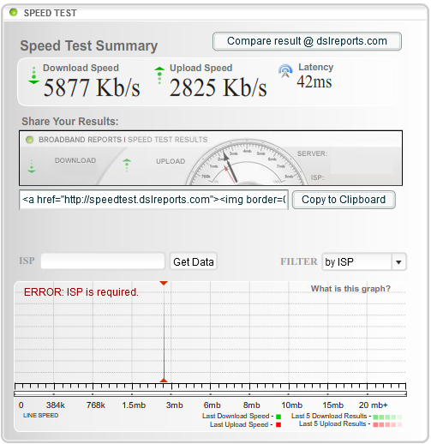
Define the Physical Layer
Go to http://www.dslreports.com
Click the Tools link
Click the Speed Tests link
Select the Flash 8 plugin based speed test
Locate a server in your area and click it
Watch as the web app tests your download and upload speed
The download speed is 5877 Kb/s which is approximately 5.8 Mb/s

Slide 14
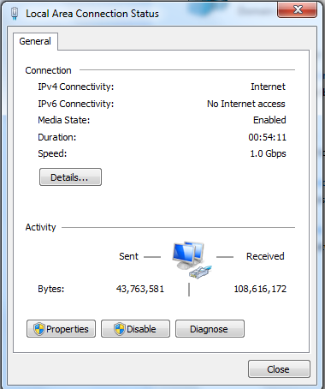
Local Area Connection Speed
Look at the Local Area Connection on your computer.
Notice the LAN connection “speed” is measured in bits as well.

Slide 15
Define the Data Link Layer
Remember that the data link layer governs devices like network adapters.
All network adapters must comply with a particular data link networking standard, such as Ethernet.

Slide 16
Ethernet Standards
LAN standard providing a communication method for high speed data exchange among devices
Defined Physical and Data Link Layer
100BASE-T
  100 for 100 Mbps
  BASE for baseband
  T for twisted-pair cabling
Baseband refers to the fact that devices on the network use digital signaling over a single frequency
Broadband systems use analog signaling over a range of frequencies enabling multiple channels over the same physical medium

Slide 17
Media Access Control (MAC) Address
Network adapters on an Ethernet network have unique Media Access Control (MAC) addresses
MAC addresses are unique identifiers assigned to network adapters by the manufacturer
MAC address is six octets in length written in hexadecimal

Slide 18
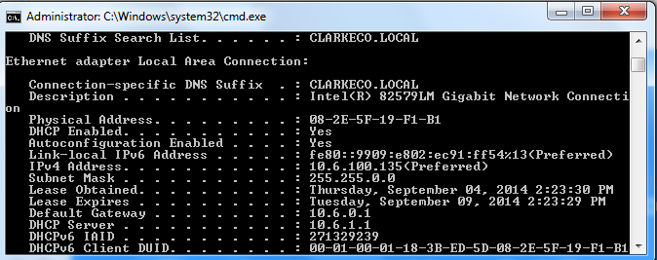
MAC Address
Access the command prompt (Windows key + R, then type cmd)
Type the command ipconfig/all

Slide 19
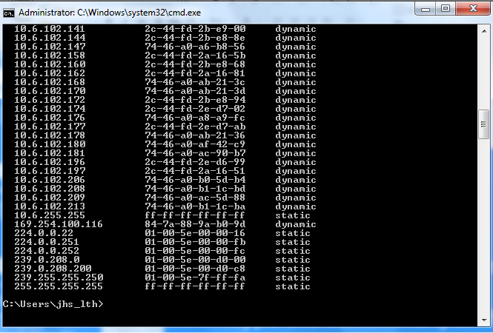
MAC addresses
To display the MAC addresses of other hosts that your computer has recently connected to, type arp -a

Slide 20
Layer 2 Switches
Layer 2 switches are hardware-based and use the MAC address of each host computer’s network adapter when deciding where to direct data frames
Layer 2 switches are also the most common type of switch used on a LAN
Ports on the switch are mapped to the specific MAC address of the device attached
00:2a:db:38:9c:f1
23:5c:f7:da:9c:32

Slide 21
Security Issues with Layer 2 Switches
Switches have memory that is set aside to store the MAC address to port translation table – the Content Addressable Memory table or CAM Table
This table can be compromised with a MAC Flood attack – an attempt to use up all the memory on the switch and change its state to failopen mode.

Slide 22
Virtual LAN (VLAN)
Layer 2 switching can also allow for a virtual LAN (VLAN) to be implemented.
A VLAN is implemented to segment and organize the network, to reduce collisions, boost performance
IEEE 802.1Q is the standard that supports VLANs
A tag is added to the data frame to identify the VLAN
VLAN2
VLAN1

Slide 23
Open the command prompt
Type ipconfig
Ping another computer on the network
Ping utilizes the Internet Control Message Protocol (ICMP)
Notice the size of the replies you receive; by default, they should be 32 bytes each
Type arp –a
You should find the IP address you just pinged
The Address Resolution Protocol is another layer 3 protocol that resolves or translates IP addresses to MAC addresses – allowing connectivity between the layer 3 IP system and the layer 2 Ethernet system.

Slide 24
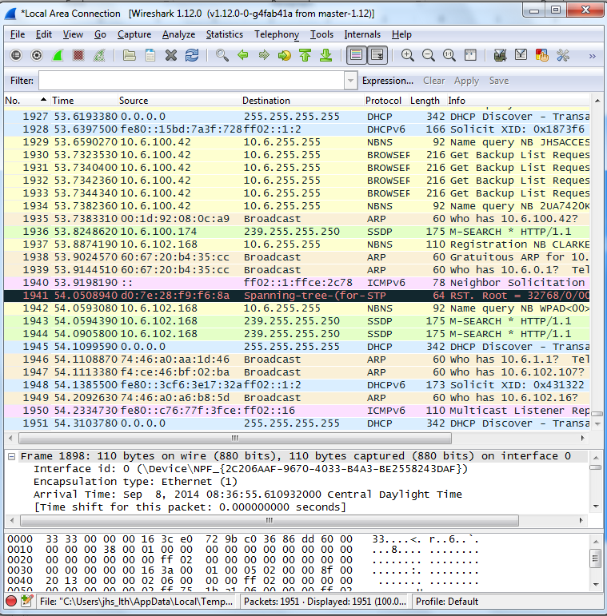
Go to http://www.wireshark.org – download and install the Wireshark protocol analyzer

Slide 25
Layer 3 – Network Layer
Controls the operations of routing and switching information to different networks
Translates logical addresses or names to physical addresses
Internet Protocol (IP) is a Network Layer protocol
Devices that work at the network layer are routers and IP switches
Network Layer components: IP addresses, subnets
Unit of measurement: packets

Slide 26
Understanding Layer 3 Switching
A layer 3 switch differs from a layer 2 switch because it determines paths for data using logical addressing (IP addresses) instead of physical addressing (MAC addresses).
Layer 3 switches are similar to routers
Layer 3 switches forward packets, whereas layer 2 switches forward frames

Slide 27
Layer 4 – Transport Layer
This layer ensures messages are delivered error-free, in sequence and with no losses or duplications
Protocols that work at this layer segment messages, ensure correct reassembly at the receiving end, perform message acknowledgement and message traffic control
The Transport Layer contains both connection-oriented and connectionless protocols
Unit of measurement used: segments or messages

Slide 28
Layer 4 Protocols
2 common TCP/IP protocols that are utilized on Layer 4 are:
  Transmission Control Protocol (TCP) which is a connection-oriented protocol
  User Datagram Protocol (UDP) which is connectionless
Examples:
  Web browsers use TCP
  Streaming media uses UDP

Slide 29
TCP and UDP
By using TCP, we are ensuring that data gets to its final destination. If a packet is lost along the way, it will be resent until the destination computer acknowledges delivery or ends the session.
With streaming media, we are either watching or listening in real time. If a packet is lost, we don’t really care, because the time frame of the video or music has already passed. Once the packet it lost, we don’t want it back.
  If the packet loss becomes to sever, the streaming media will become incomprehensible

Slide 30
TCP and UDP
TCP transport is used for logging on, file and print sharing, replication of information between domain controllers, transfer of browse lists, and other common functions. TCP can only be used for one-to-one communications.
UDP is often used for one-to-many communications, using broadcast or multicast IP datagrams
Protocol | Type | Example
Transmission Control Protocol (TCP) | Connection-oriented | Web browser
User Datagram Protocol (UDP) | Connectionless | Streaming media

Slide 31
Connection Oriented Communications
Require both devices involved in the communication establish an end-to-end logical connection before data can be sent
These communications are considered reliable network services
Packets not received by the destination device can be resent by the sender

Slide 32
Connectionless Communications
End-to-end connection is not necessary before data is sent
Every packet that is sent has the destination address in the header
Sufficient to move independent packets, such as in streaming media
Datagram delivery is not guaranteed and lost packets cannot be resent

Slide 33
Connection-based Protocols
The Transport Layer contains both connection-oriented and connectionless protocols
Transmission Control Protocol (TCP) provides a connection-based, reliable, byte-stream service to programs
User Datagram Protocol (UDP) provides a connectionless, unreliable transport service

Slide 34
Ports
Ports are a Layer 4 protocol that a computer uses for data transmission
Ports act as logical communications endpoint for specific program on computers for delivery of data sent
There are a total of 65,536 ports, numbering between 0 and 65,535
Ports are defined by the Internet Assigned Numbers Authority or IANA and divided into categories

Slide 35
IANA Port Categories
Port Range | Category Type | Description
0-1023 | Well-known ports | This range defines commonly used protocols (e.g., FTP utilizes port 21 to accept client connections).
1024-49,151 | Registered ports | Ports used by vendors for proprietary applications. These must be registered with the IANA (e.g., Microsoft registered 3389 for use with the Remote Desktop Protocol).
49,152-65,535 | Dynamic and private ports | These ports can be used by applications, but they cannot be registered by vendors.

Slide 36
Inbound & Outbound Ports
Port numbers correspond to specific applications; for example, port 80 is used by web browsers via the HTTP protocol.
Inbound ports are used when another computer wants to connect to a service or application running on your computer.
  A server’s IP/port 66.249.91.104:80 is the IP address 66.249.91.104 with port number 80 open in order to accept incoming web page requests.
Outbound ports are used when your computer wants to connect to a service or application running on another computer.

Slide 37
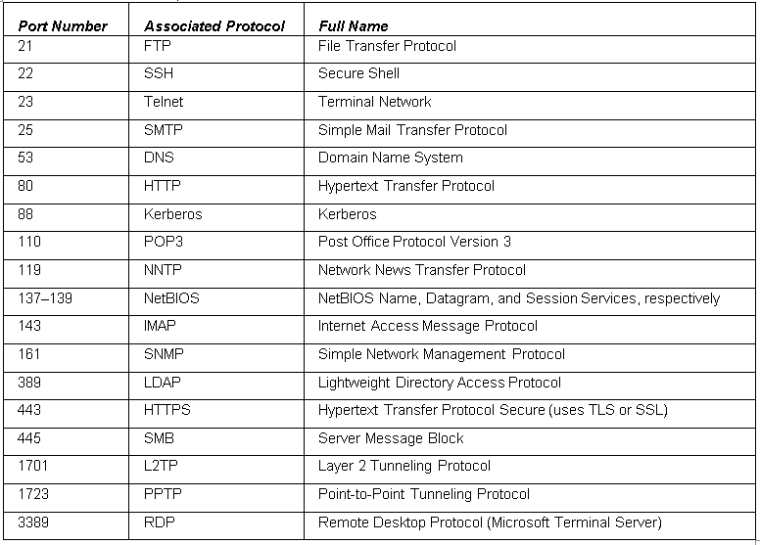
Ports & Associated Protocols

Slide 38
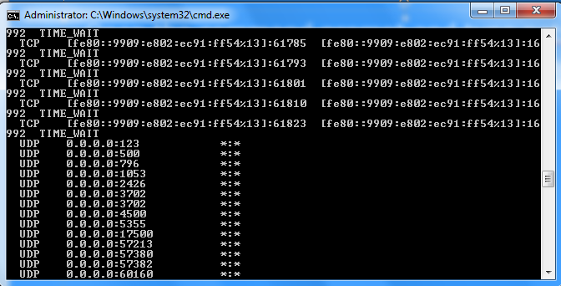
Define the Transport Layer
Open the command prompt and type netstat –an
This will display all the connections to and from your computer in numeric format

Slide 39
Define the Session Layer
Every time you connect to a Web site, a mail server, or any other computer on your network or another network, your computer is starting a session with that remote computer.
Each time you log on or log off of a network, the session layer is involved.
NetBIOS (Network Basic Input Output System) is a protocol that works at this layer

Slide 40
Define the Presentation Layer
The presentation layer will change how data is presented.
It could include code conversion from one computer system to another, or it could be encryption or compression.
This layer also comes into play with you connect to a mapped network drive.

Slide 41
Define the Application Layer
Serves as a the window for users and application processes to access network services
This layer is where message creation begins
End-user protocols such as FTP, SMTP, Telnet, and RAS work at this layer
This layer is not the application itself, but the protocols that are initiated by this layer

Slide 42
OSI Model
Layer | Protocol | Device
7 – Application | FTP, HTTP, POP3, SMTP | Gateway
6 – Presentation | Compression, Encryption | N/A
5 – Session | Logon/Logoff | N/A
4 – Transport | TCP, UDP | N/A
3 – Network | IP, ICMP, ARP, RIP | Routers
2 – Data Link | 802.3, 803.5 | NICs, Switches, Bridges, WAPs
1 – Physical | 100BASE-T, 1000BASE-X | Hubs, Patch Panels, RJ45 Jacks

Slide 43
TCP/IP Model
The TCP/IP model is similar to the OSI model
This model is composed of only four layers
Layer | Description | Protocols
Application Layer | Defines TCP/IP application protocols | HTTP, Telnet, FTP, SMNP, DNS
Transport Layer | Provides communication session management | TCP, UDP, RTP
Internet Layer | Packages and routes data | IP, ICMP, ARP, RARP
Network Interface | Details how data is physically sent through the network | Ethernet, Token Ring, Frame Relay

Slide 44
OSI Model compared to TCP Model
OSI Model | TCP Model
Application Layer | Application Layer
Presentation Layer
Session Layer
Transport Layer | Transport Layer
Network Layer | Internet Layer
Data Link Layer | Network Access Layer
Physical Layer
The OSI Physical layer is skipped altogether on the TCP model

Slide 45
How many layers are incorporated in the OSI model communications subnetwork?
2
7
3
4
Notes:
7

Slide 46
Which of the following layers deal with the serial transfer of data?
Physical
Data link
Network
Session
Notes:
Physical

Slide 47
You need to install a router on your company’s network that will allow access to the Internet. What layer of the OSI does this device reside on?
Physical
Data link
Network
Transport
Notes:
Network

Slide 48
You run netstat –an command in the command prompt and notice many connections being made that say TCP in the left-most column. What layer of the OSI is TCP referring to?
Layer 1
Layer 2
Layer 3
Layer 4
Notes:
Layer 4 – Transport Layer

Slide 49
You suspect a problem with your computer’s network adapter and its ability to send the correct frames of data that correspond with the network architecture used by the rest of your computers. What layer should you attempt to use as a troubleshooting starting point?
Physical
Data link
Network
Transport
Notes:
Data link

Slide 50
A standard such as 100BASE-T refers to which OSI layer?
Physical
Data link
Network
Transport
Notes:
Physical layer

Slide 51
Almost all of your users connect to Web sites with IE. They usually type domain names such as www.microsoft.com. What protocol is initiated by default when they press Enter after typing the domain name?
FTP
HTTPS
HTTP
HTP
Notes:
HTTP

Slide 52
You need to find out the MAC address of your director's computer. He has given you permission to access his computer. You access the command prompt. What command should you type to see the computer's MAC address?
Ipconfig
Ipconfig/all
Arp
Netstat -an
Notes:
Ipconfig/all

Slide 53
You need to find out the MAC addresses of all the computers that a particular user's computer has connected to in the recent past. What command should you use to accomplish this?
Ping 127.0.0.1
Netstat –a
Arp –a
Arp -s
Notes:
Arp -a

Slide 54
You have been instructed to capture and analyze packets on a server. What tool will allow you to do this?
Protocol Analyzer
Command Propt
Netstat –an
Wireshark
Notes:
Protocol Analyzer

Slide 55
The manager of IT asks you to ping his laptop to see whether your computer can find it on the network. In this scenario, the __________ protocol is being implemented.
Notes:
Internet Control Message Protocol (ICMP)

Slide 56
A ___________ switch is one that uses logical addressing to determine data paths.
Notes:
Layer 3 (Network Layer)

Slide 57
Ports 1024-49,151 are ports used by vendors for proprietary applications. They are known as ________ ports.
Notes:
Registered ports

Slide 58
Port ____________ is used by the File Transfer Protocol.
Notes:
21

Slide 59
Your manager wants you to allow HTTP and HTTPS connections to the company web server. In order to do this , you need to open inbound ports __________ and ___________.
Notes:
80 & 443

Slide 60
Your company hosts a DNS server that resolves domain names to IP addresses. This server must have port ___________ open to service those requests for name resolutions.
Notes:
53

Slide 61
You need to find out the Internet connections a particular computer has made in the recent past. You also need to see numeric information so that you know the IP address and port numbers of the destination computers. You should type the ___________ in the command prompt.
Notes:
Netstat -an

Slide 62
The IT director asks you to connect a client computer to an 802.3ab network. This network uses the __________ standard.
Notes:
Ethernet

Slide 63
A user has connected to a Web site. The information that is sent to that user's computer is encrypted in an encoded format. This change to the data occurs at the ___________ layer.
Notes:
Layer 6 (Presentation Layer)

Slide 64
As you delve into a packet of data with your protocol analyzer, you notice that the frame size is bigger than the packet size. This is because the packet is ___________ inside the frame.
Notes:
Encapsulated

Slide 65
What model is used to describe how data communication occurs between hosts?
Notes:
OSI Reference Model

Slide 66
Which layer in the OSI model do MAC addresses and switches use?
Notes:
Data link

Slide 67
Which layer in the OSI model covers routing between networks?
Notes:
Network

Slide 68
Which layer in the OSI model is used to verify that data was delivered without error?
Notes:
Network

Slide 69
Which layer in the OSI model covers HTTP, FTP, and RDC?
Notes:
Application

Slide 70
Which layer of the OSI model is used to create a connection so that a host can transfer files?
Notes:
Session

Slide 71
Which layer of the OSI model includes VLANs?
Notes:
Data link

Slide 72
Which protocol do you use as the transport protocol for a video application?
Notes:
UDP

Slide 73
Which port categories include inbound ports of HTTP, HTTPS, FTP, and DNS?
Notes:
Well known ports

Slide 74
What layer in the OSI model is used to encrypt data?
Notes:
Presentation

Slide 75
Which layer in the OSI model includes the cable and network adapters?
Notes:
Physical

Slide 76
How many layers does the TCP/IP model have?
Notes:
4

Slide 77
Which layer in the OSI model is included in the TCP/IP model?
Notes:
Transport

Slide 78
Which protocol is used to translate IP addresses to MAC addresses?
Notes:
Address Resolution Protocol (ARP)

Slide 79
What ports are defined above 49,152?
Notes:
Dynamic Ports

Slide 80
A layer 3 switch is similar to a ___________.
Notes:
Router

